Slide 1

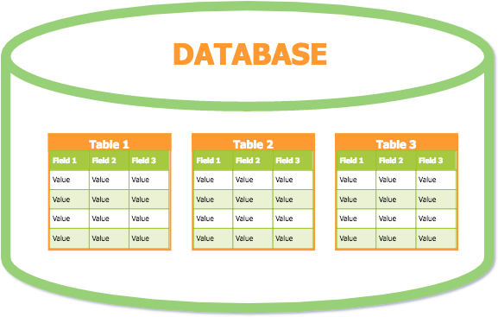
Databases
Data Manipulation in SQL
1

Slide 2
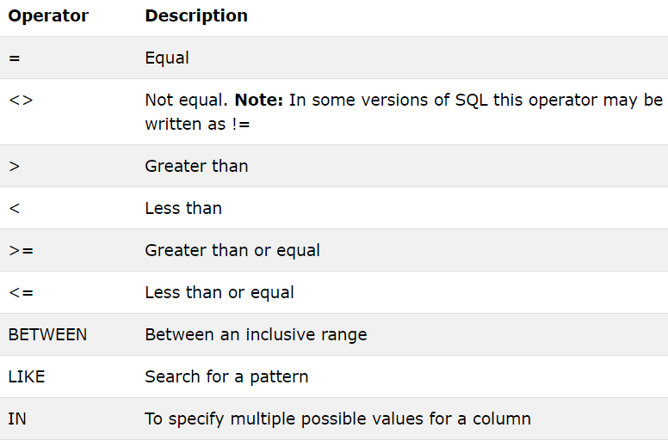
Operators used in WHERE Clause

Slide 3
AND, OR and NOT Operators
The WHERE clause is combined with these operators to filter records.
AND and OR operators are used to filter records based on more than one condition.
AND - Displays a record if all the conditions are TRUE.
OR - Displays a record if any of the conditions are TRUE.
NOT - Displays a record if the condition is NOT TRUE.

Slide 4
Combining AND, OR and NOT
Can combine AND, OR and NOT operators a single WHERE clause.
Have to use parenthesis “( )” to establish the order of precedence.
If the parenthesis are not used, then the order of evaluation will be;
NOT
AND
OR

Slide 5
BETWEEN Operator
Used to selects values within a given range.
The values can be numbers, text, or dates.
The BETWEEN operator is inclusive: begin and end values are included.
BETWEEN <lowest_value> AND <highest_value>

Slide 6
LIKE Operator
Used in a WHERE clause to search for a specified pattern in a field.
There are two wildcard characters used in conjunction with the LIKE operator to substitute any other character(s) in a string.
% (Percentage sign):
Represents zero, one, or multiple characters
_ (Underscore):
Represents a single character

Slide 7
Character List Wildcard
Used to define sets and ranges of characters (list of characters) to match or not match.
[charlist] - Defines sets and ranges of characters to match
[^charlist] or [!charlist] - Defines sets and ranges of characters NOT to match

Slide 8
IN Operator
Allows to specify multiple values in a WHERE clause.
The IN operator is a shorthand for multiple OR conditions.
SELECT <Field names> FROM <Table_Name> WHERE <Field_Name> IN (<Value1, Value2>, ...)

Slide 9
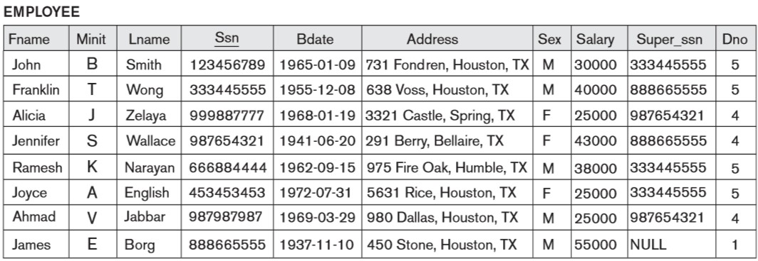
Exercise

Slide 10
Exercise
Display the ssn and first name of male employees working in department 5 and female employees working in department 4.
Retrieve the ssn, name and DOB of employees who were born in 1960 -1970.
Display the surnames of employees whose surname contains a vowel as the 2nd letter.
Retrieve the names of employees whose first name is not ‘John, Alicia and Ramesh’.

Slide 11
ORDER BY
Used to arrange (sort) the rows according to specific criteria.
ASC - Order rows in ascending order (Default)
DESC - Order rows in descending order

Slide 12
Order of Execution
SELECT <attribute list>
FROM <table list> WHERE <condition> ORDER BY <attribute list>

Slide 13
Exercise
Display all details in ascending order of surname.
Display all details in ascending order of salary and descending order of surname.

Slide 14
GROUP BY
This clause is used to group the result-set by one or more columns.
Often used with aggregate functions.
SELECT <Field_names> FROM <Table_Name> GROUP BY <Field_name>

Slide 15
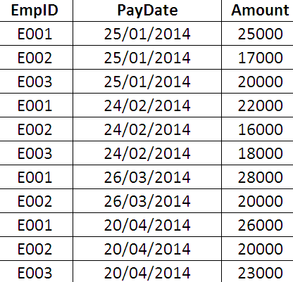
Exercise
Payment Table
Display all the salary records of each employee together.
Display the total amount earned by each employee.

Slide 16
HAVING
Often used with the GROUP BY clause to apply a filter condition to the columns that appear in the GROUP BY clause.
If the GROUP BY clause is omitted, the HAVING clause behaves like the WHERE clause.
Notice:
HAVING clause applies the condition to each group of rows.
WHERE clause applies the condition to each individual row.

Slide 17
Exercise
Payment Table
Display the maximum salary record of employee ‘E002’.
Display only the records with amount greater than 20000 in descending order of EmpID .

Slide 18
Order of Execution
SELECT <attribute and function list>
FROM <table list> WHERE <condition>
GROUP BY <grouping attribute(s)> HAVING <group condition> ORDER BY <attribute list>

Slide 19
SQL Sub Queries
A Sub query (Inner query/ Nested query) is a query within another SQL query and embedded within the WHERE clause.
Enclose sub query in parentheses.
Can’t apply on columns containing text.
Return a single value or list of values.

Slide 20
Return a single value
Display ssn, fname and surname of all the employee who work in the same department where employee
‘333445555’ is working.

Slide 21
Return a list of values
Display ssn, fname and Department No of all the employee who work in departments located at ‘Houston’.

Slide 22
Built-in Functions
SQL Server has many built-in functions.
String functions
Numeric functions
Date functions
Conversion functions
Advanced functions

Slide 23
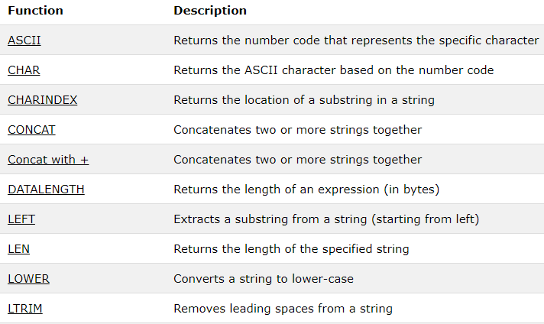
String functions

Slide 24
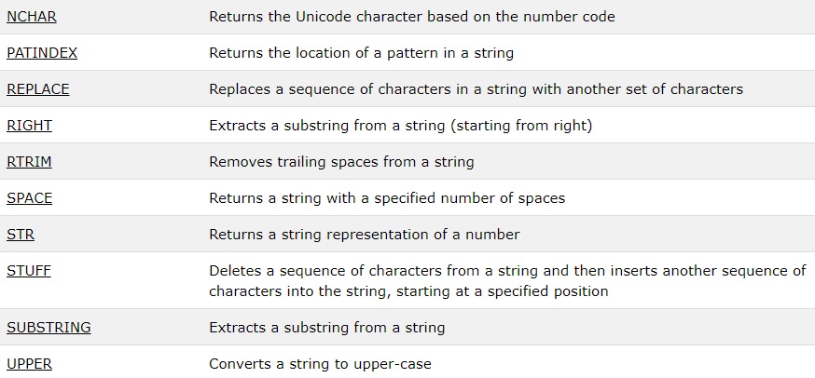
String functions

Slide 25
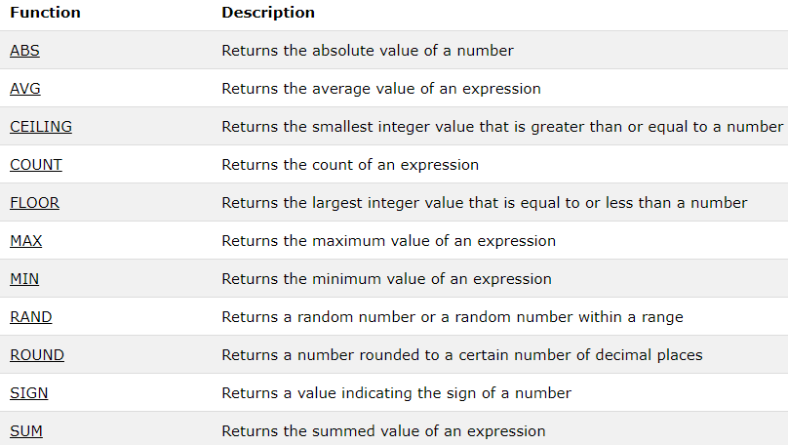
Numeric Functions

Slide 26
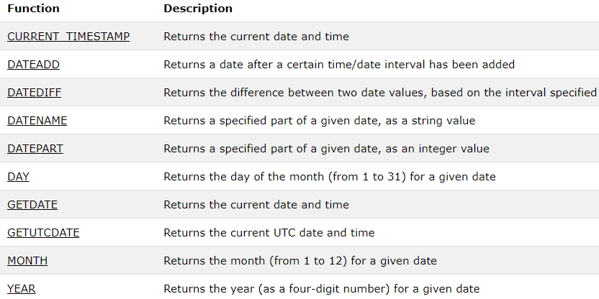
Date Functions

Slide 27
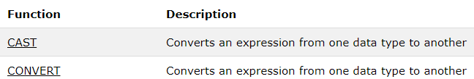
Conversion Functions

Slide 28
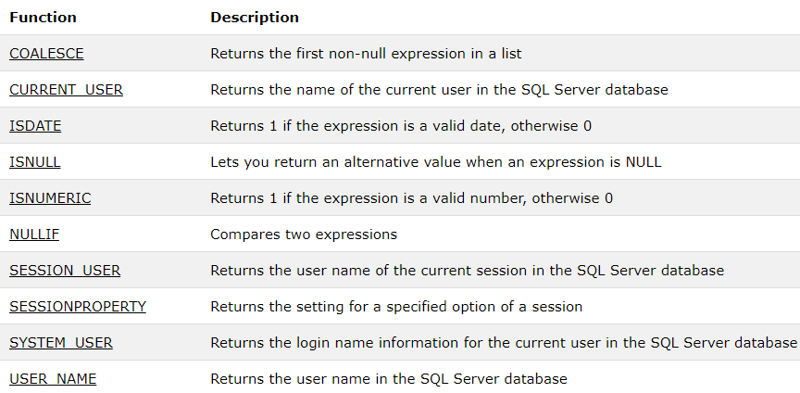
Advanced Functions

Slide 29
Thank You
29

